Slide 1
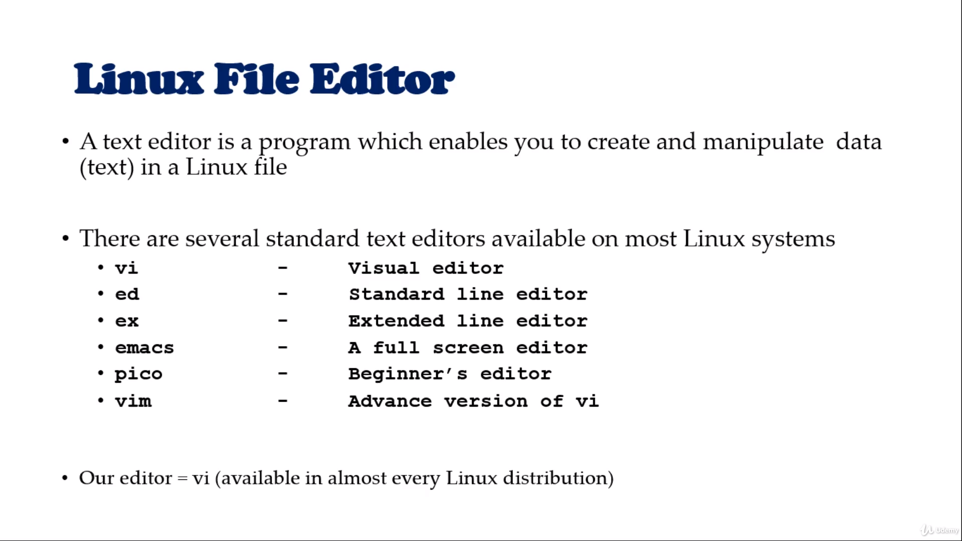

Slide 2
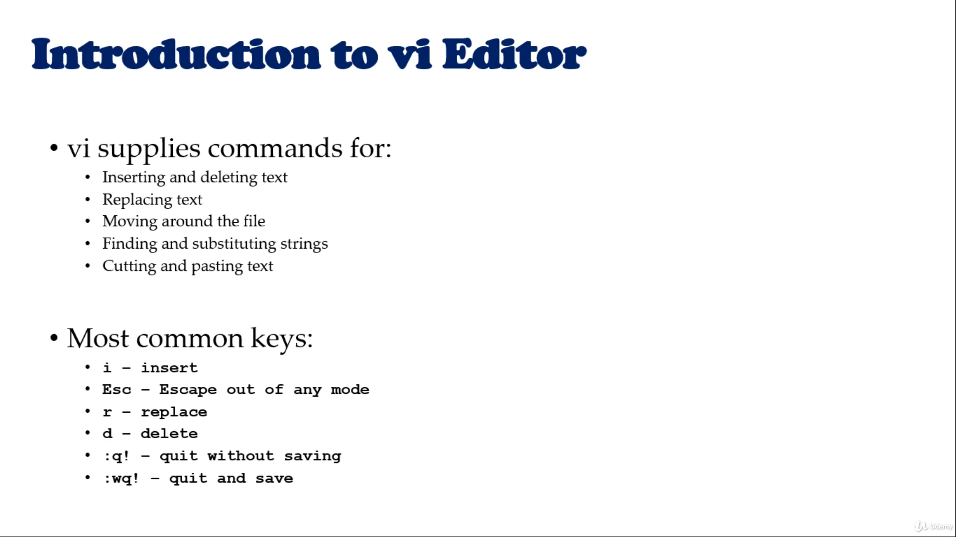

Slide 3


Slide 4


Slide 5


Slide 6
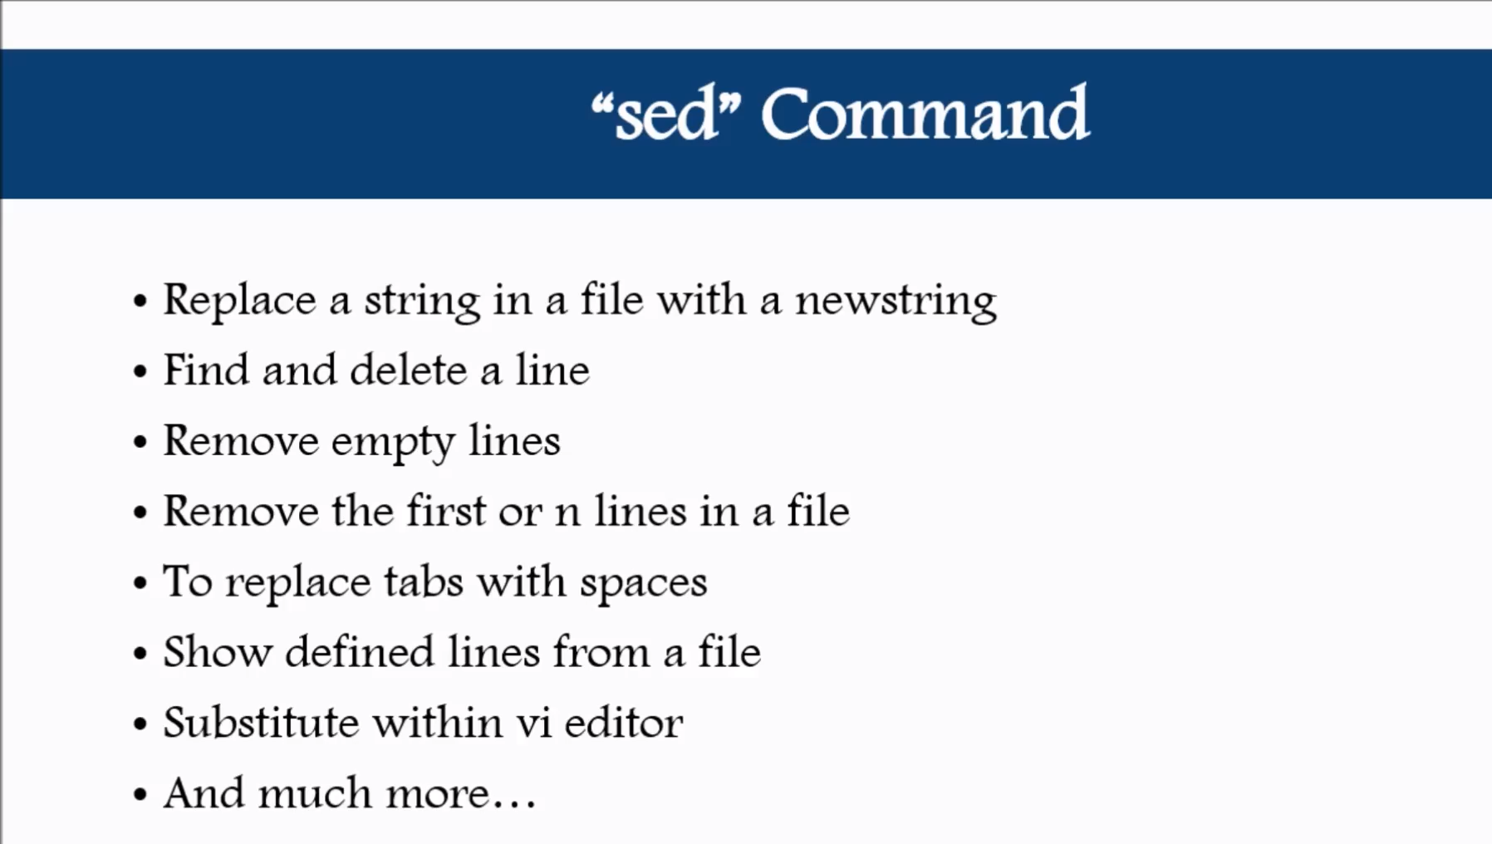

Slide 7
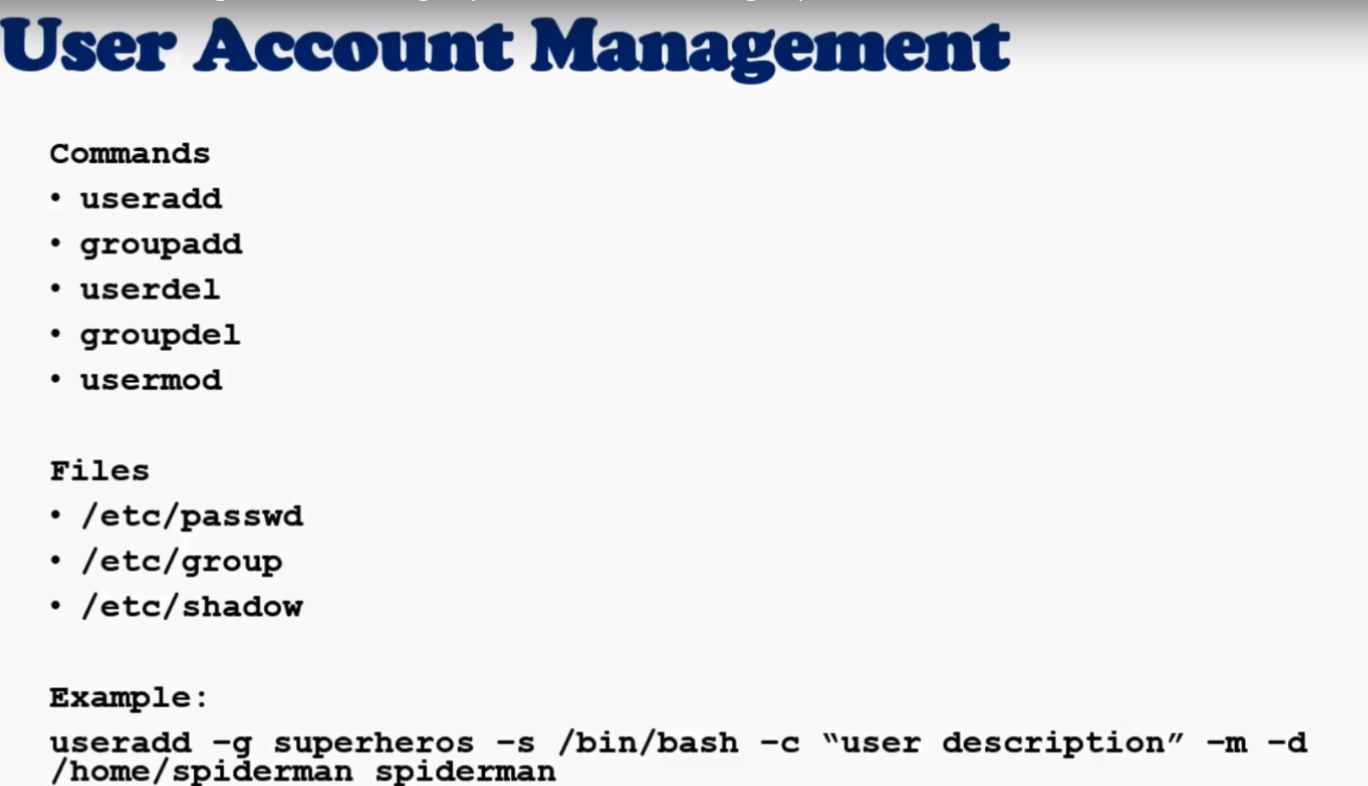

Slide 8
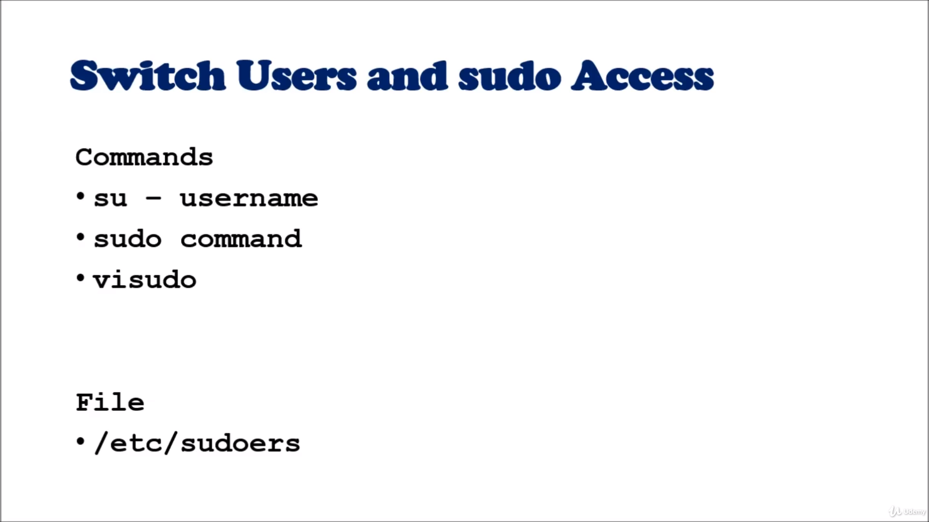

Slide 9


Slide 10



Slide 11
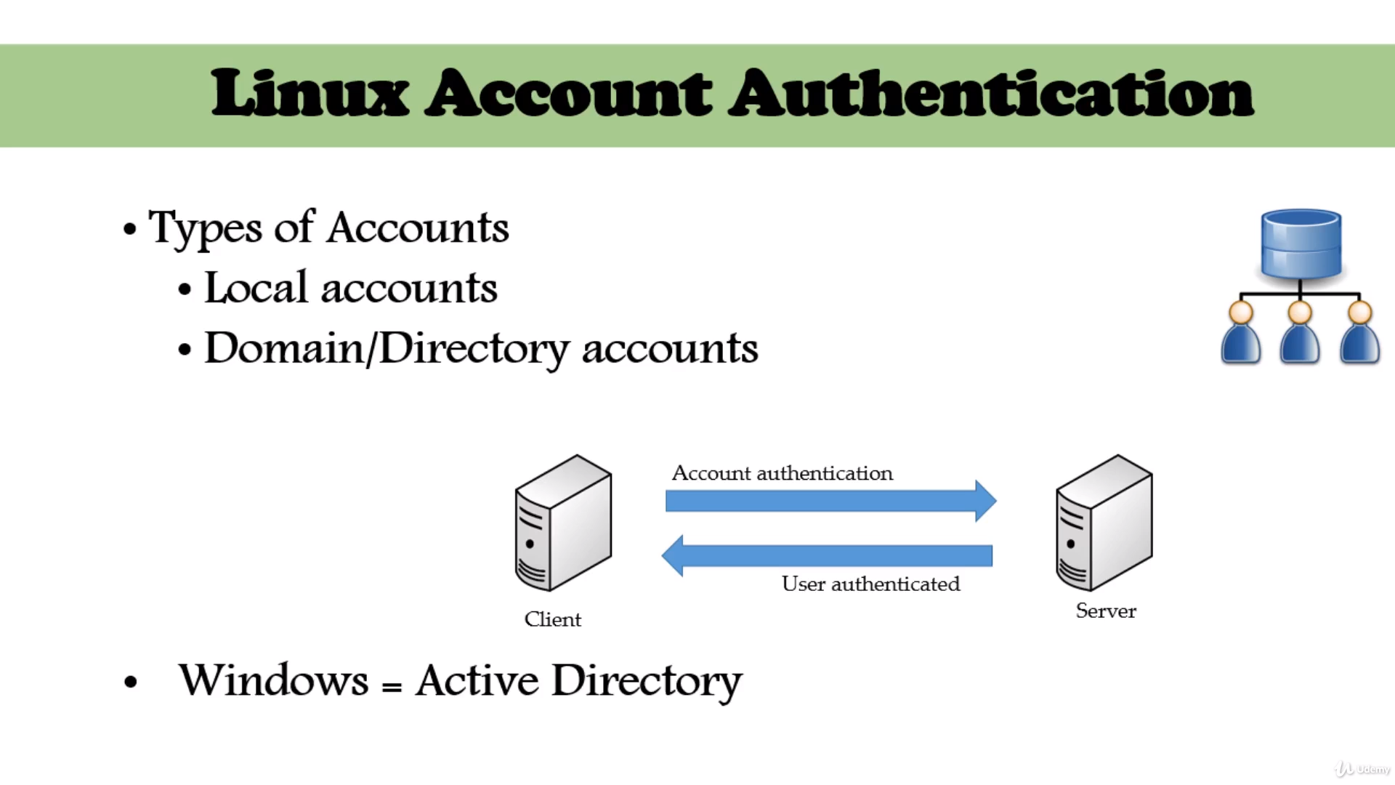

Slide 12
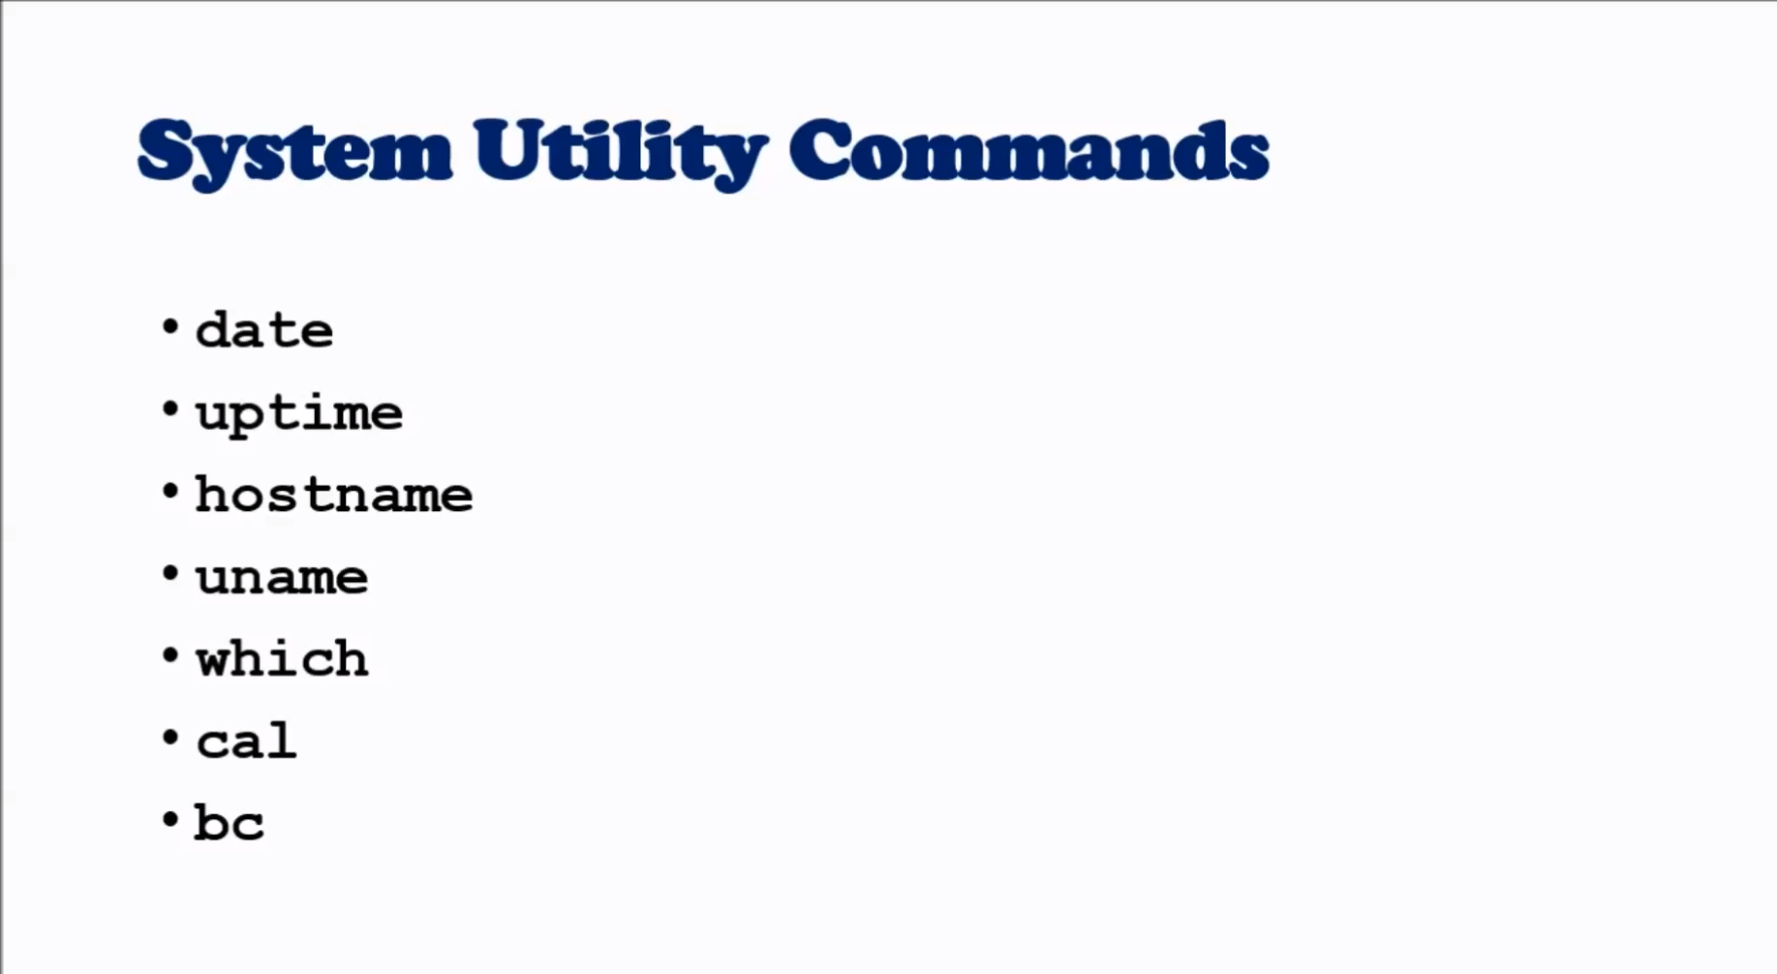

Slide 13
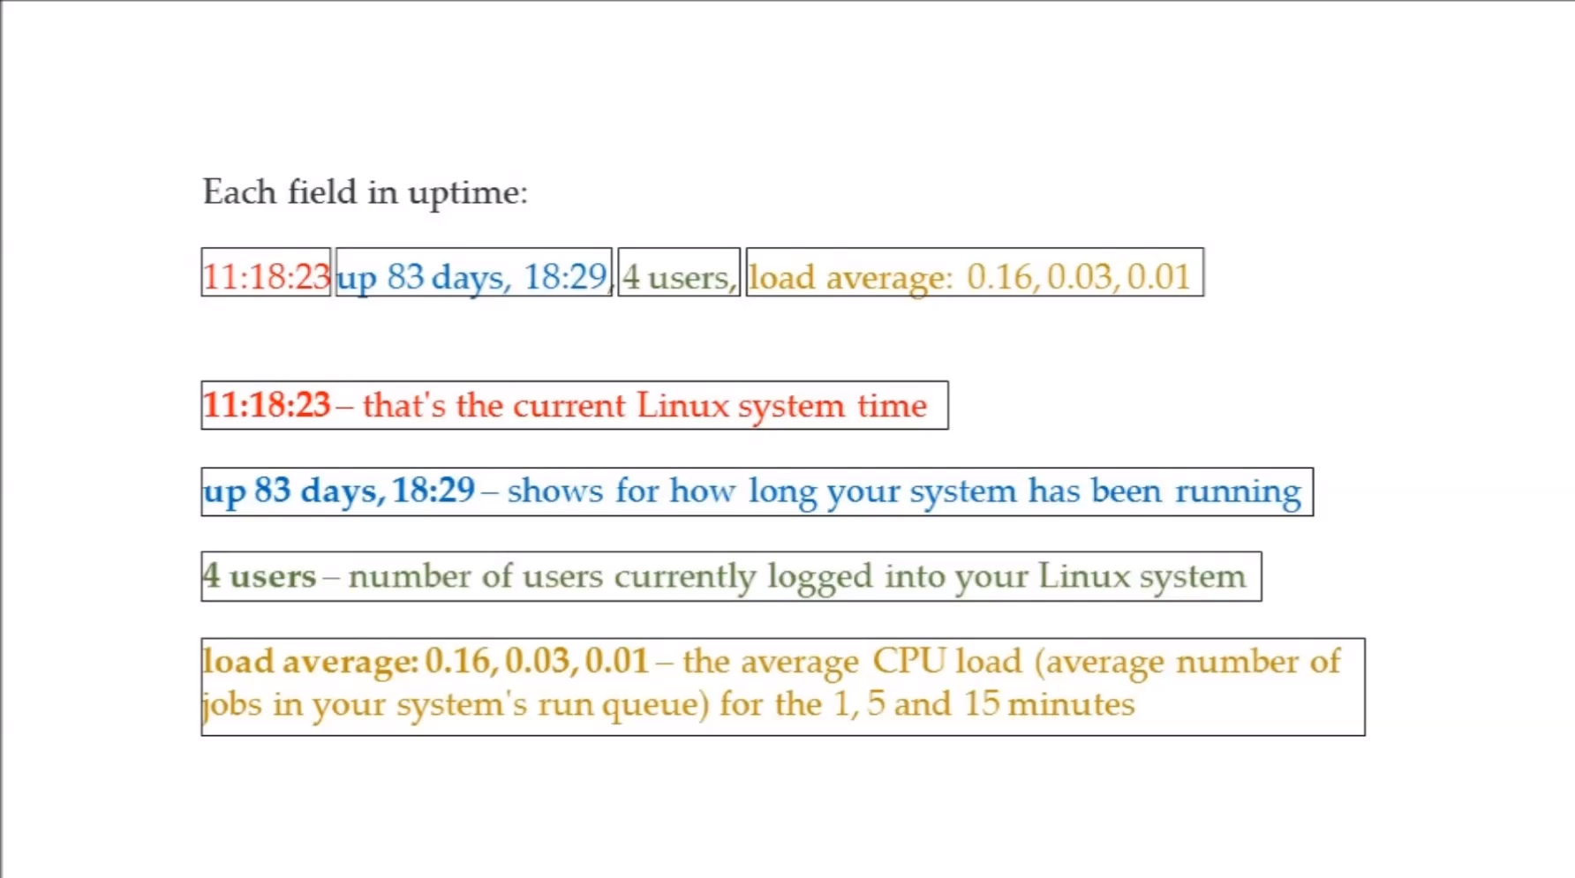

Slide 14
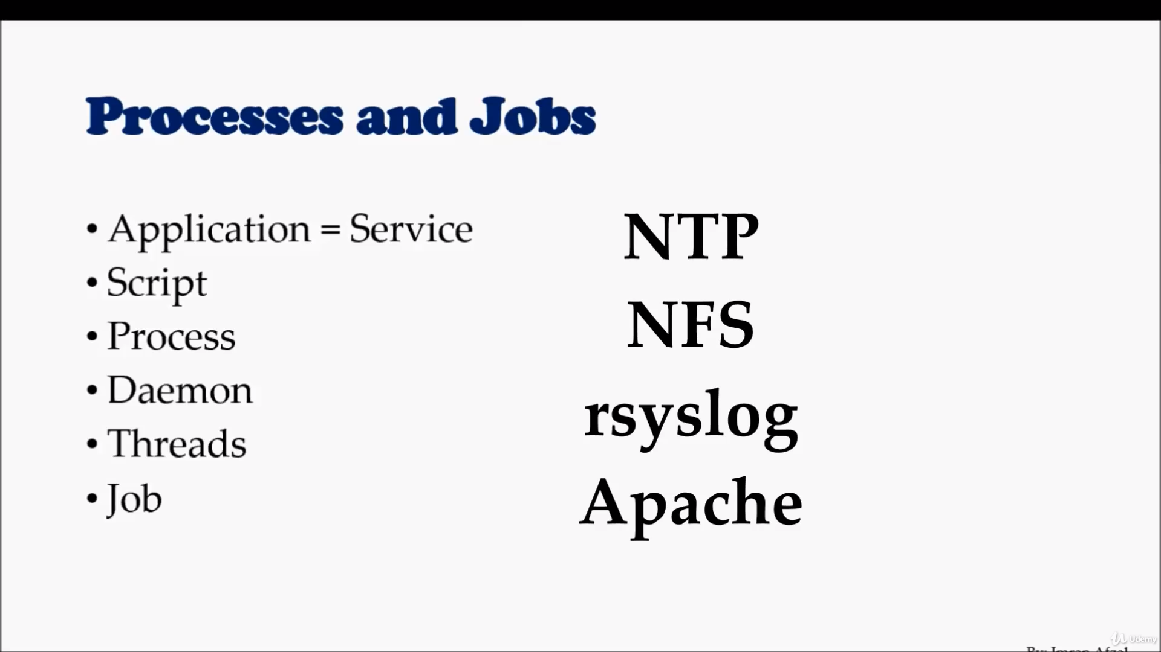

Slide 15
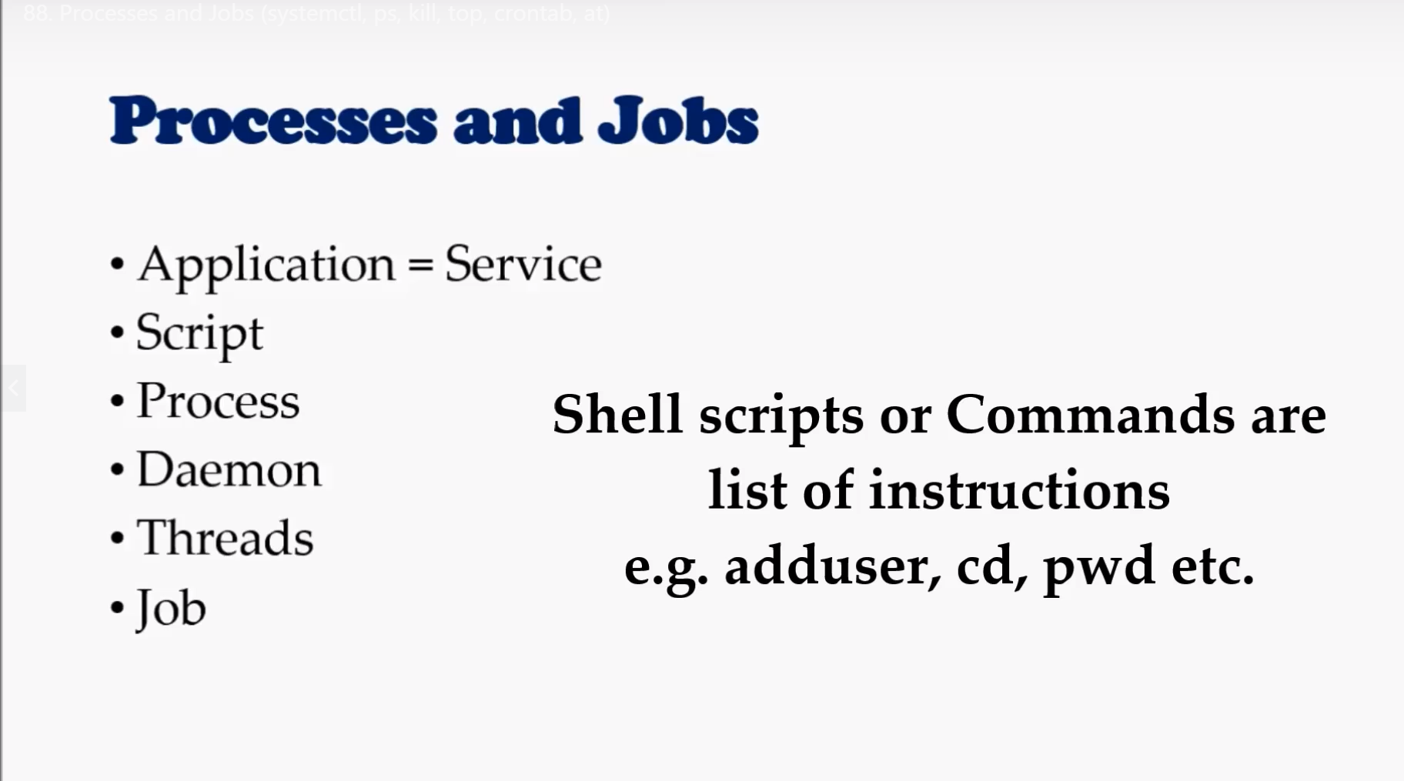

Slide 16
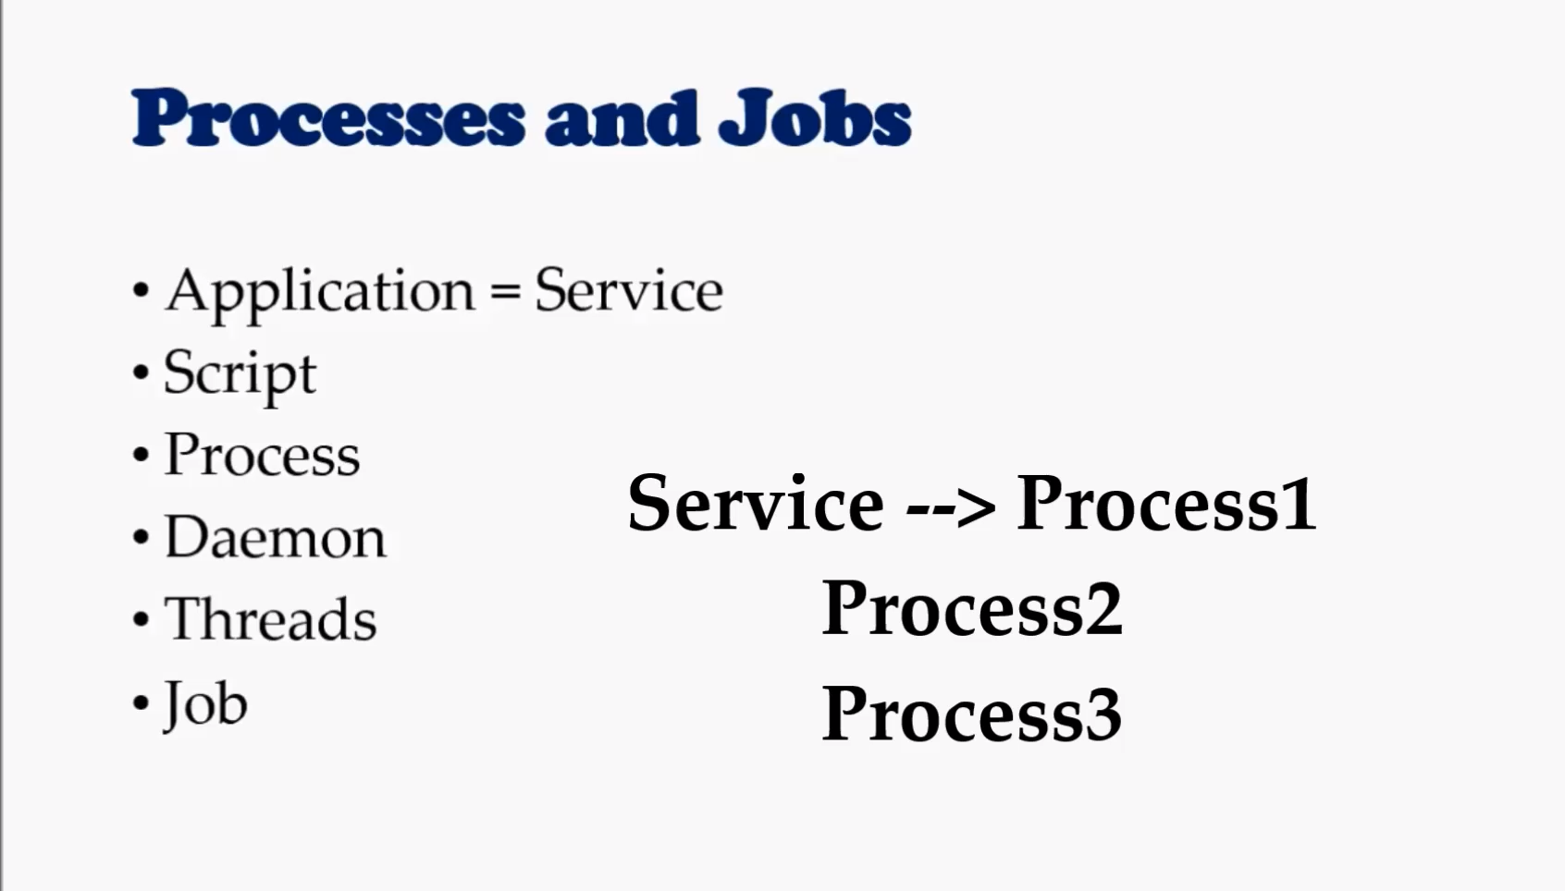

Slide 17
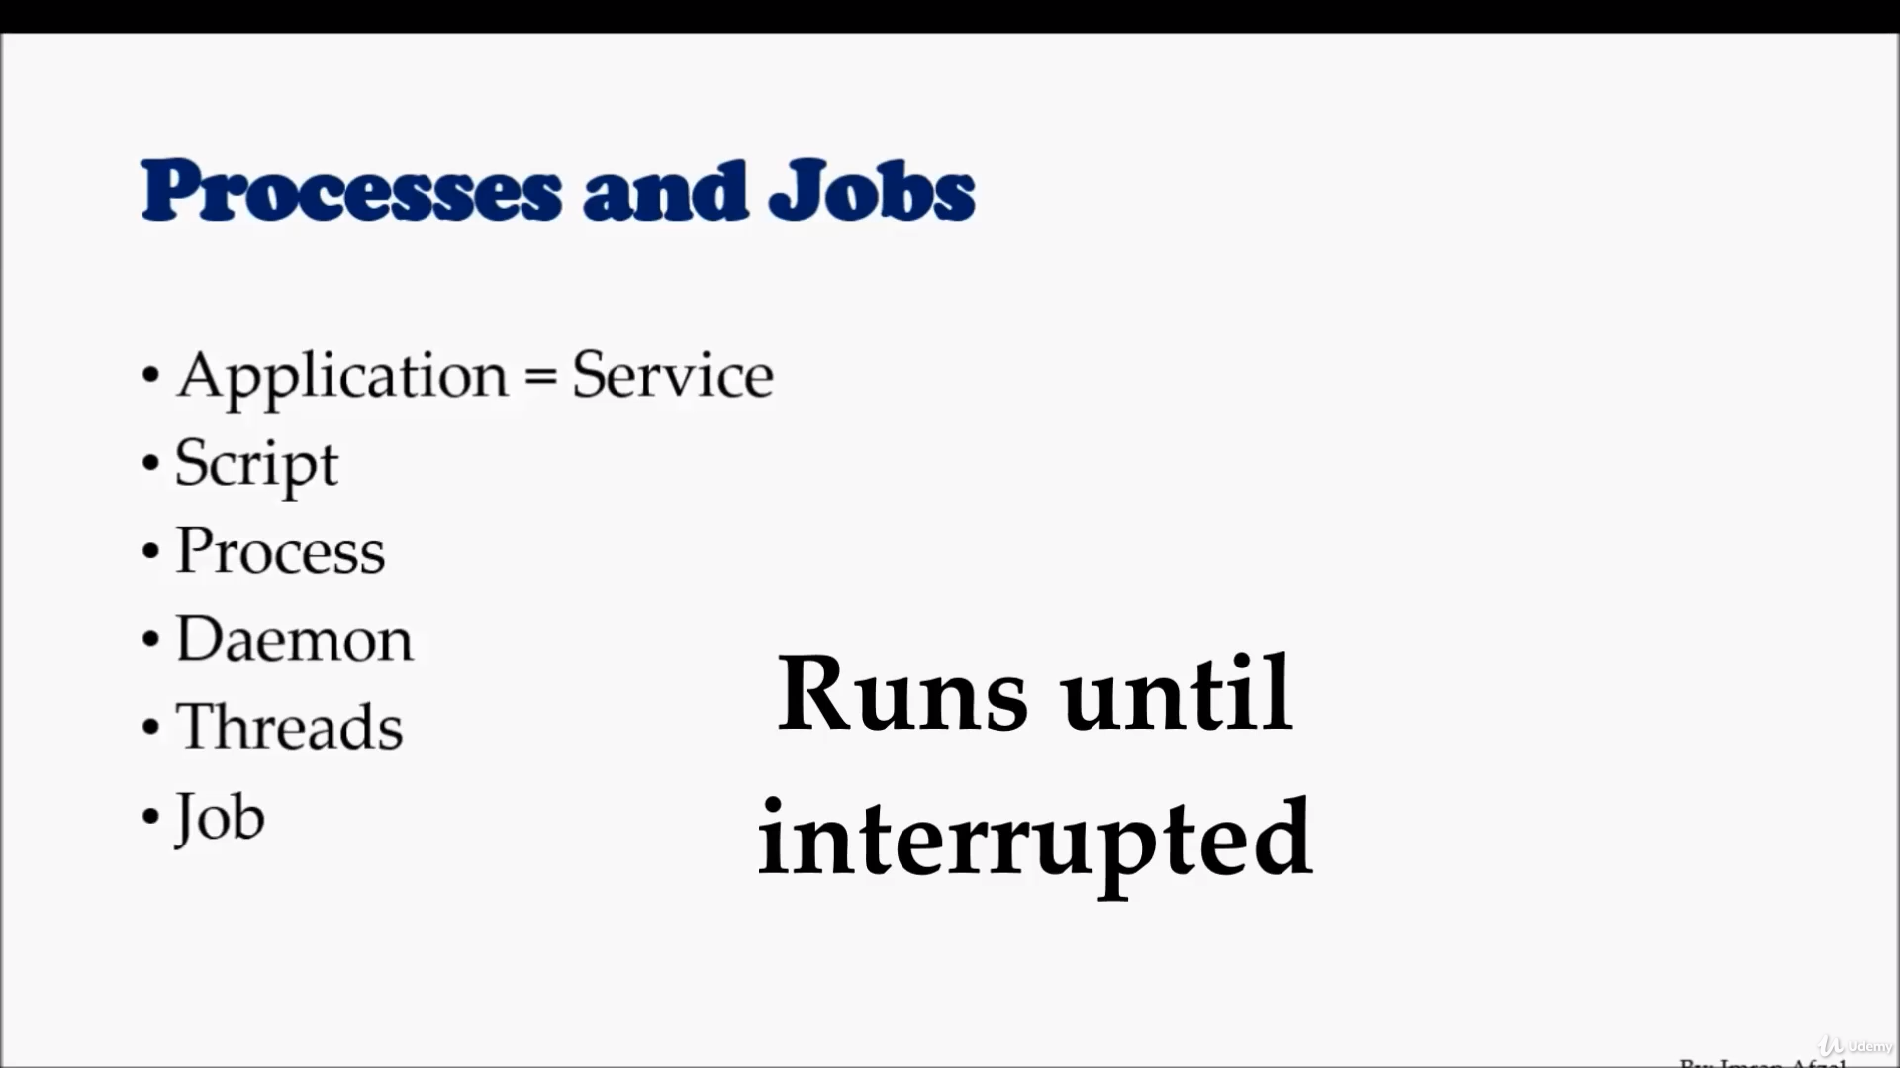

Slide 18
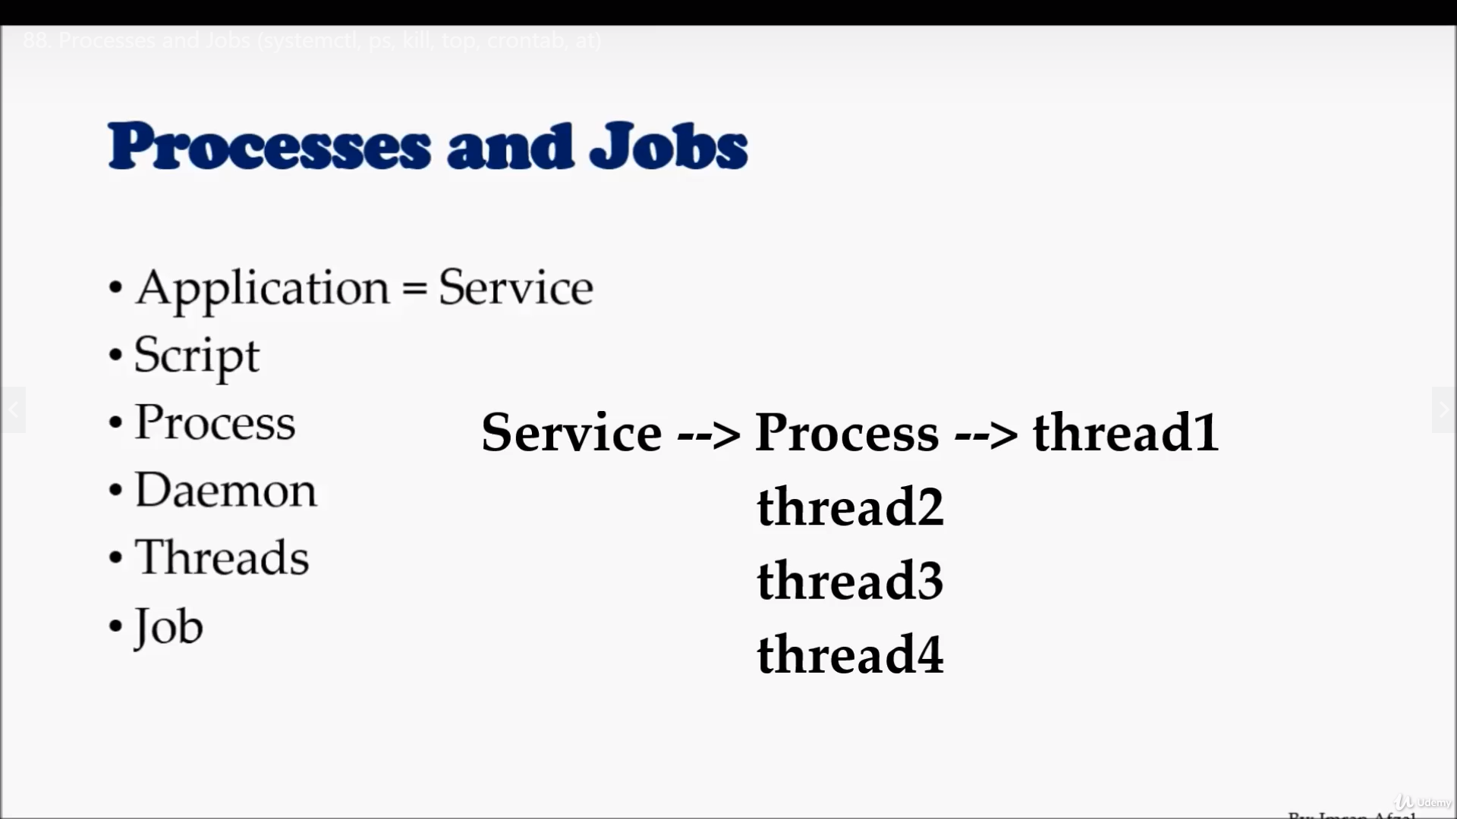

Slide 19
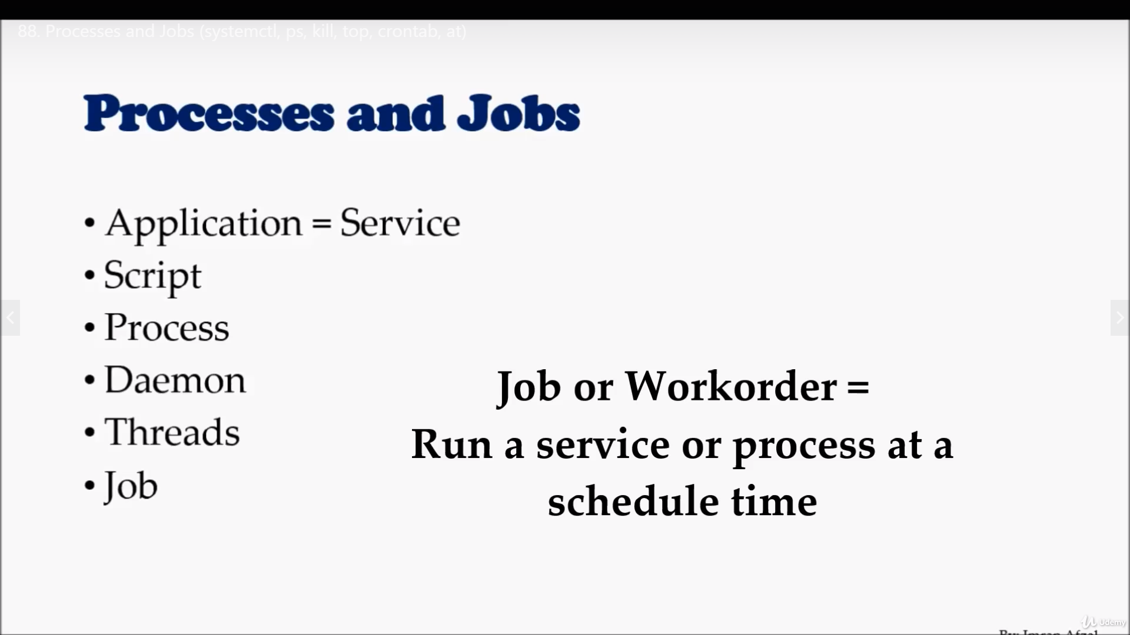

Slide 20
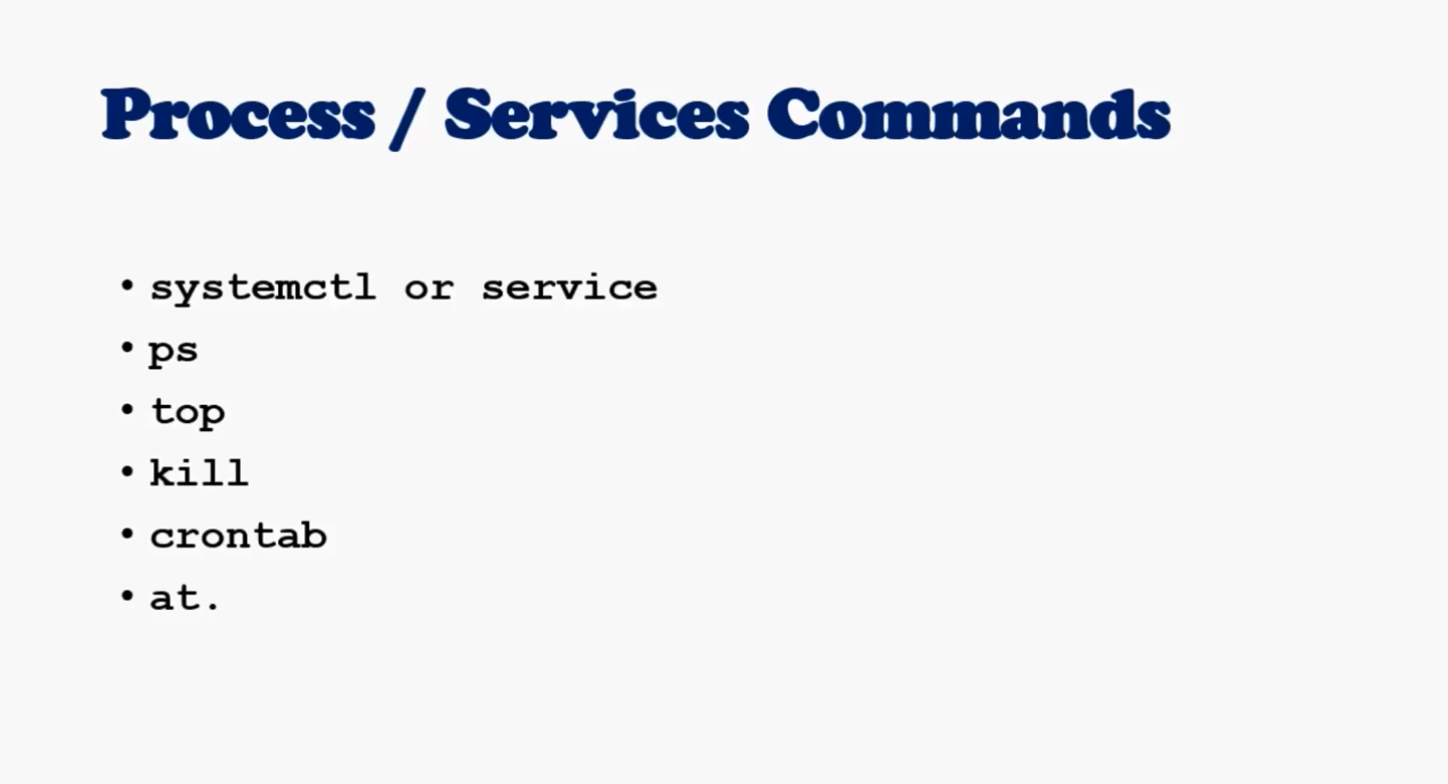

Slide 21
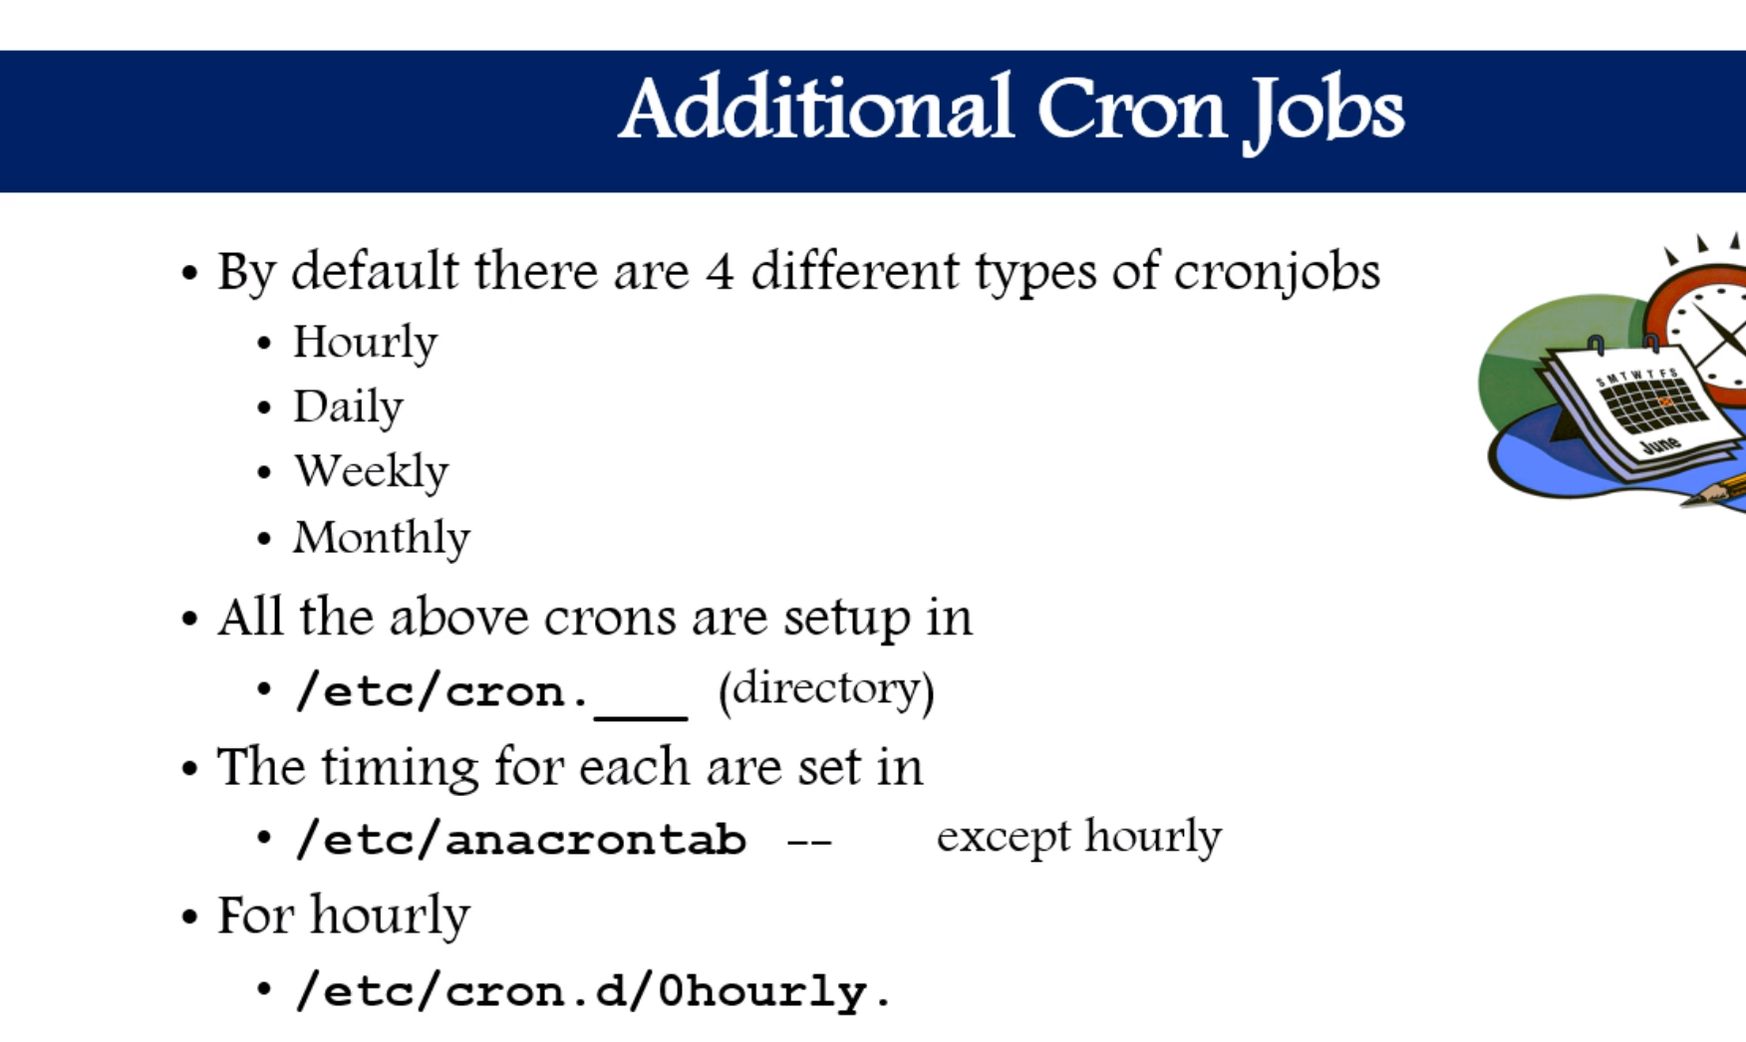

Slide 22
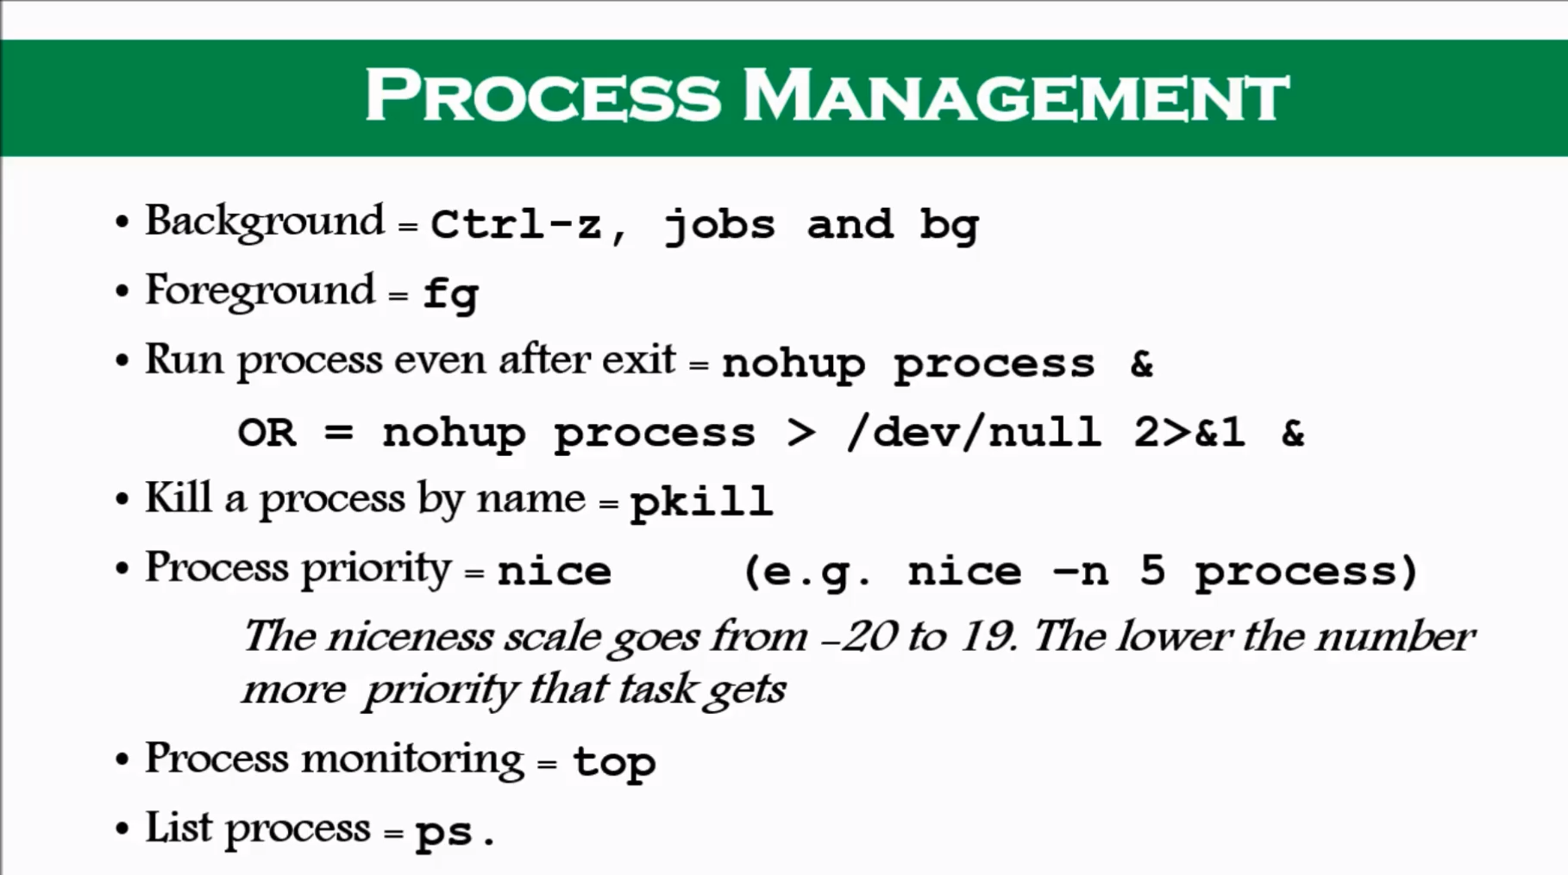

Slide 23
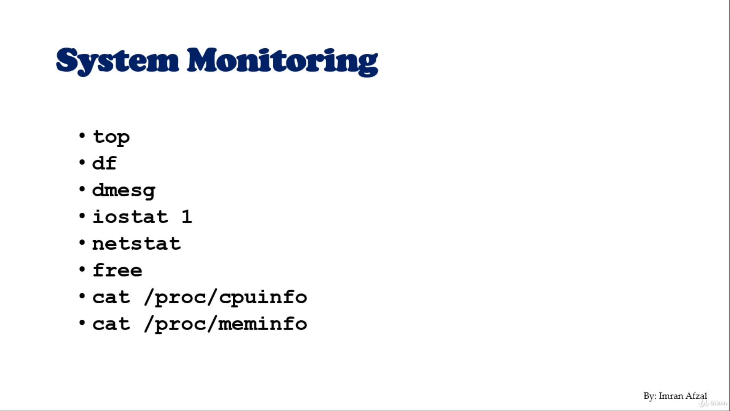

Slide 24
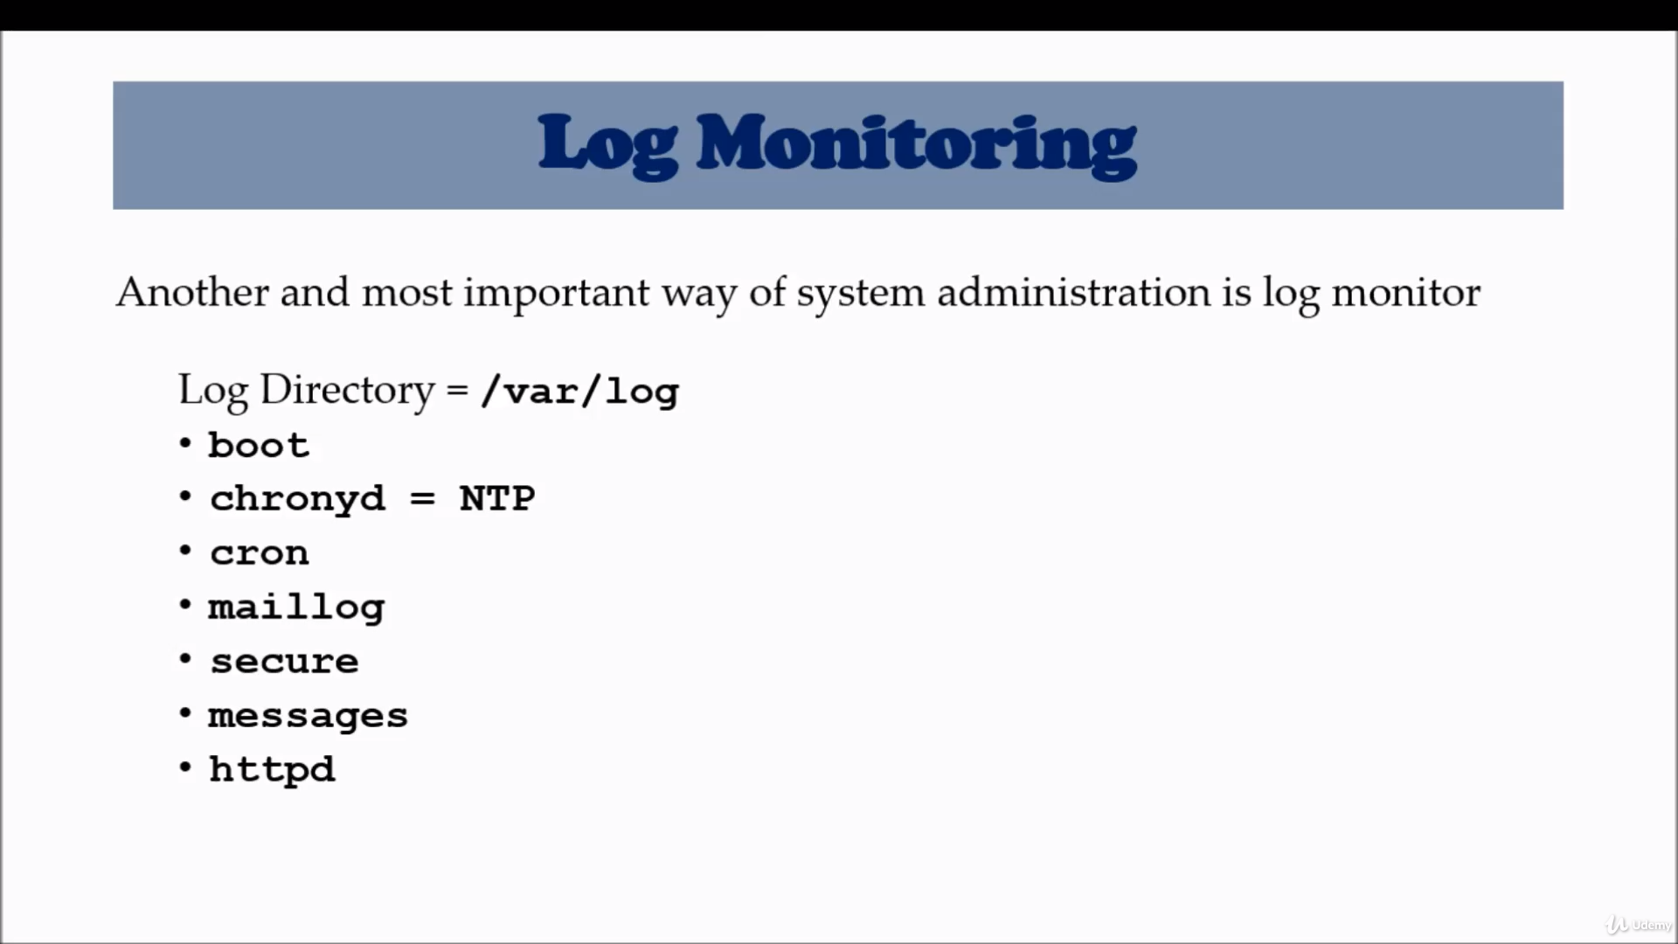

Slide 25
System Maintenance Commands
Shutdown
Init 0-6
Reboot
Halt

Slide 26
Changing Hostname
Hostnamectl set-hostname newhostname
File : in 7 ----- edit /etc/hostname

Slide 27
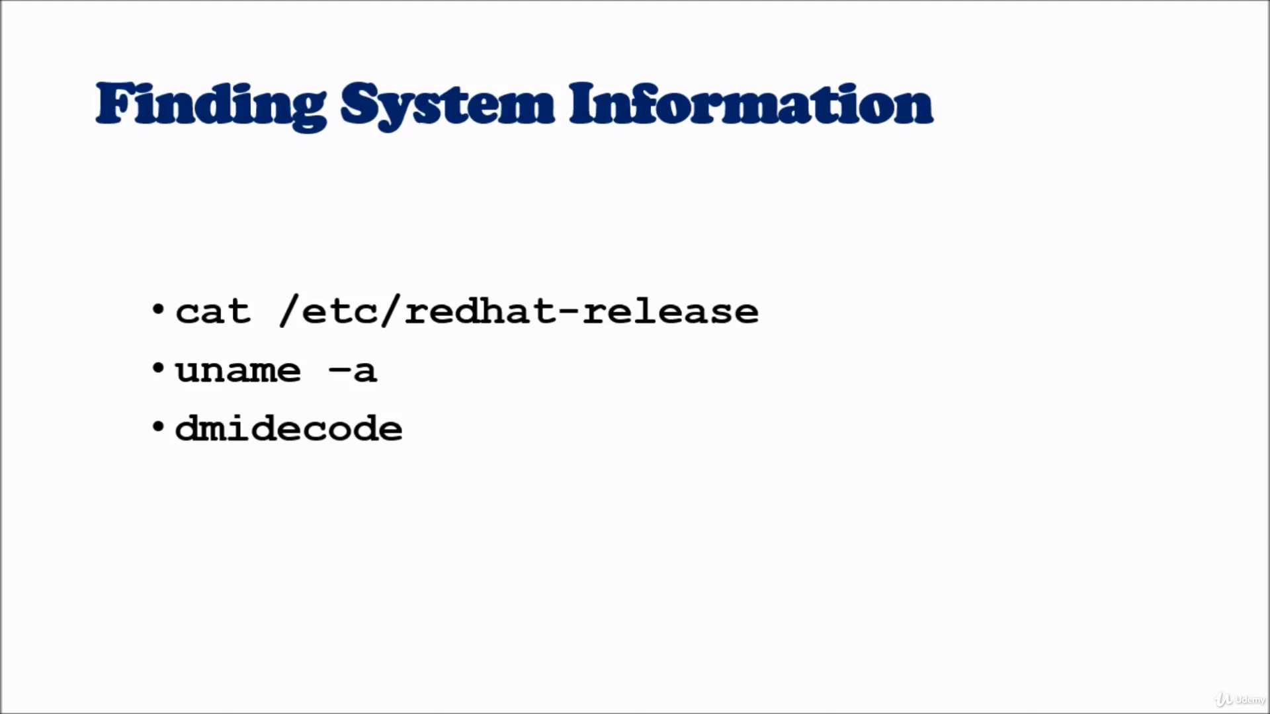

Slide 28
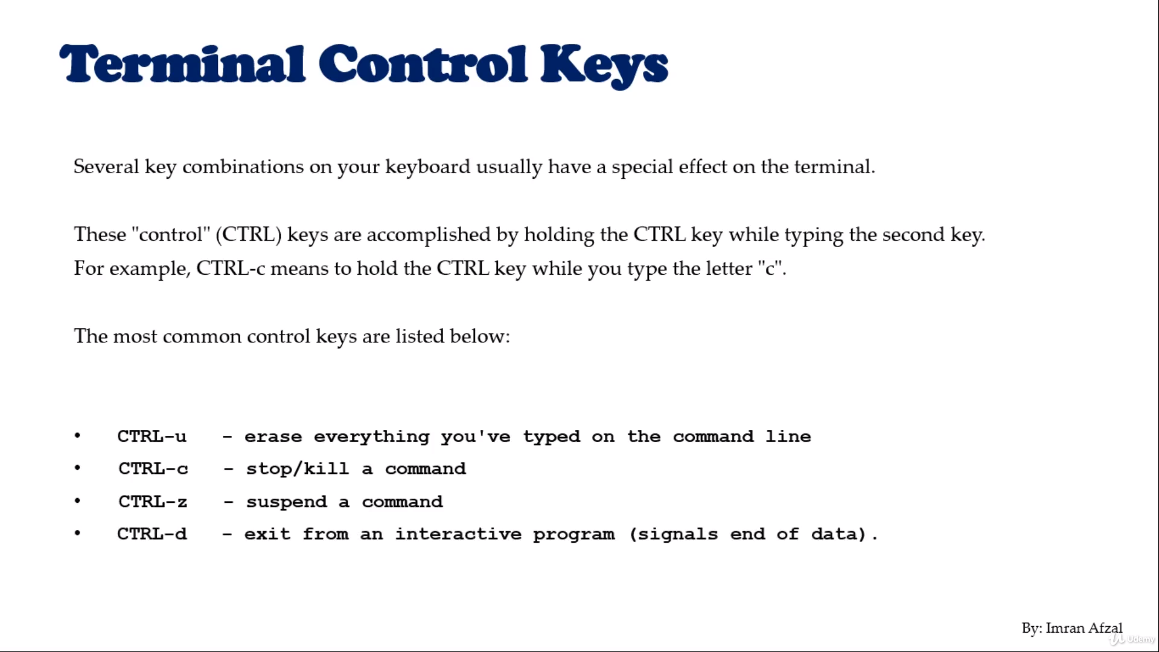

Slide 29
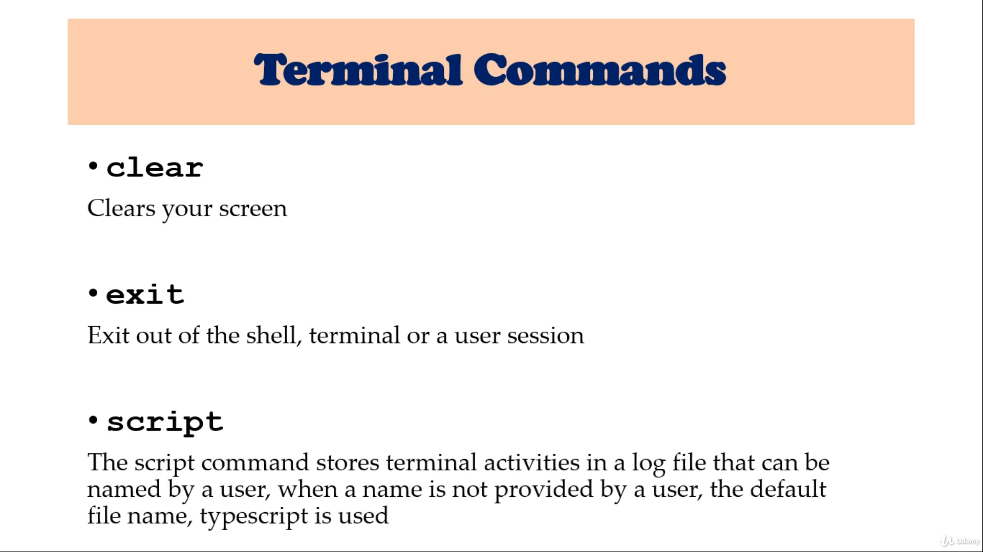

Slide 30
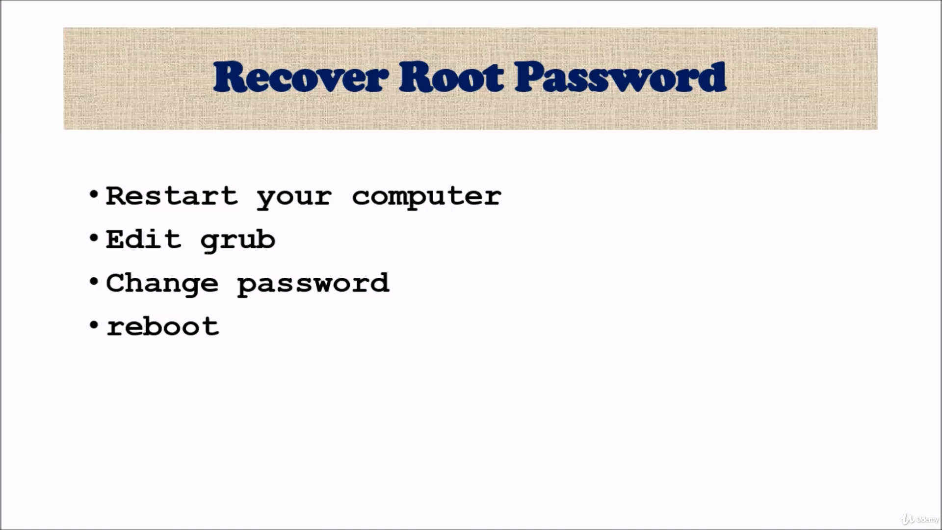

Slide 31
Steps For Root Password Change
Reboot system
Press “e”
ro - remove it
rw init=/sysroot/bin/sh
Ctrl-x
Chroot /sysroot
Passwd root
Newpasswd
Exit
reboot

